Slide 1


Data Science module V

Slide 2
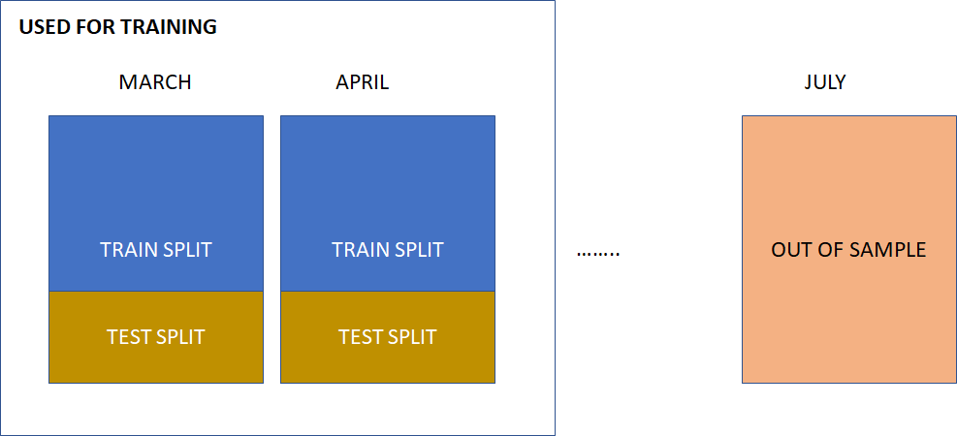
Out of Sample Evaluation

Slide 3
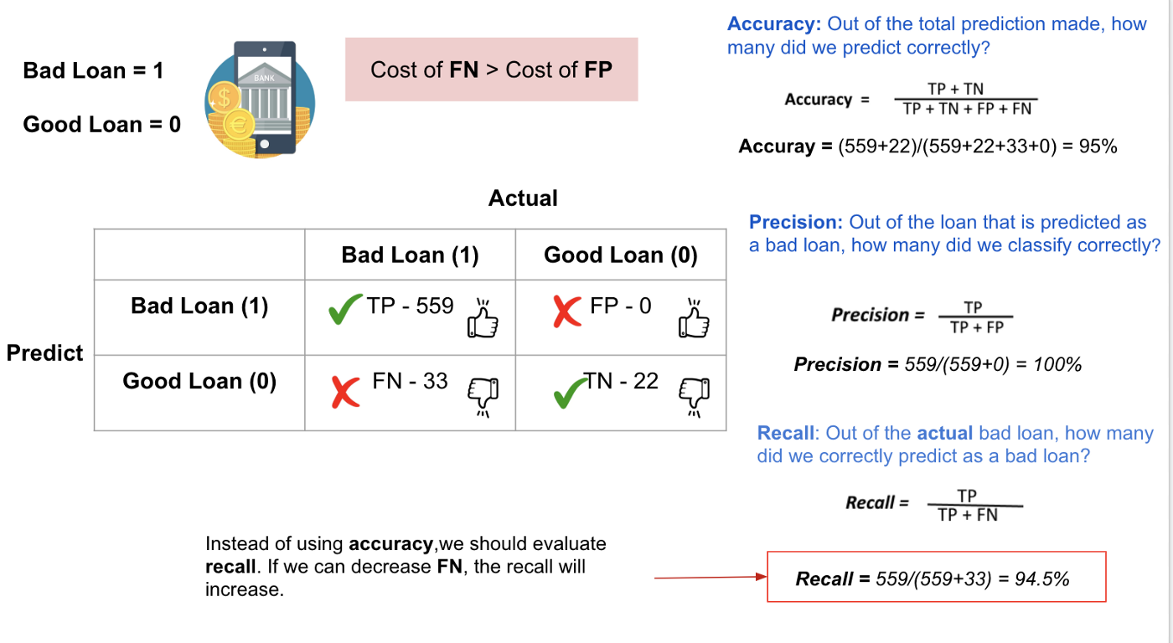
Out of Sample Evaluation

Slide 4
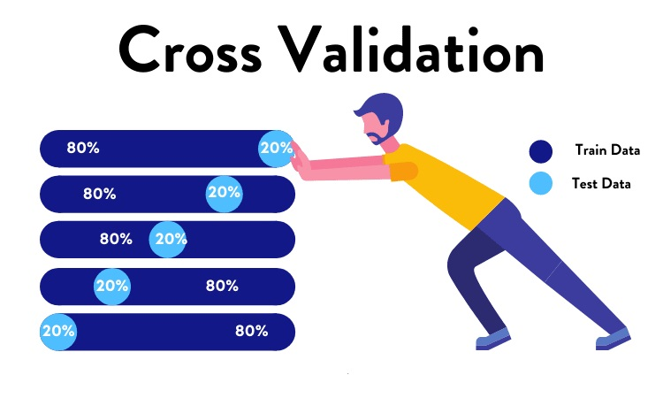

Slide 5
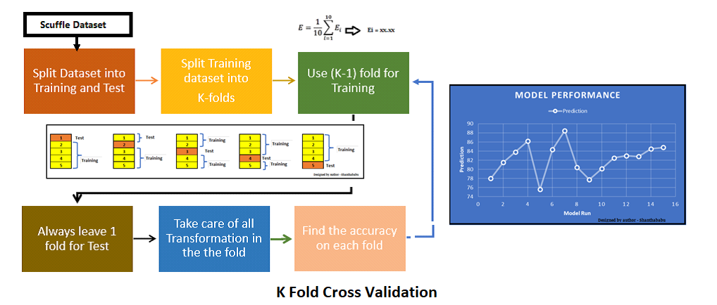
K-fold cross-validation

Slide 6
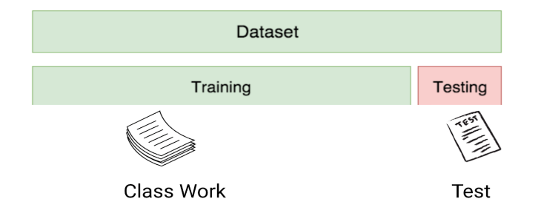
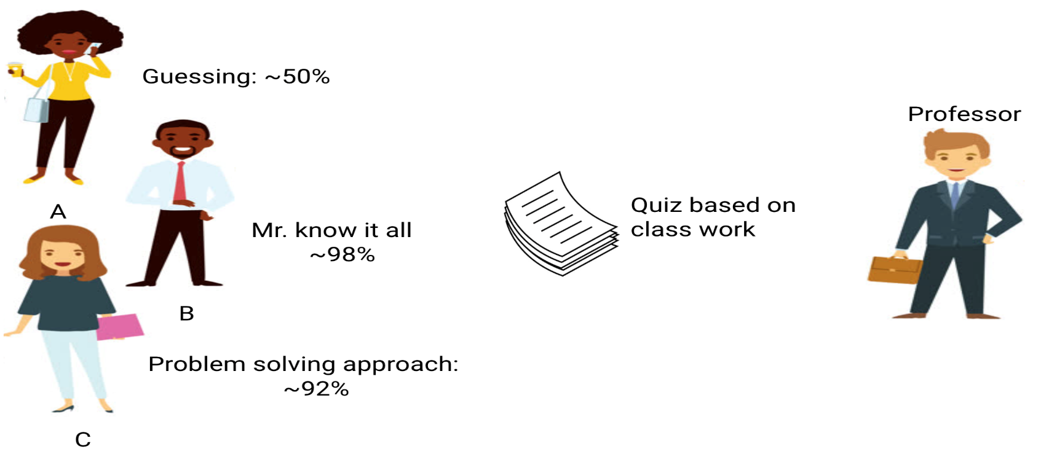
Over-fitting & Under-fitting

Slide 7
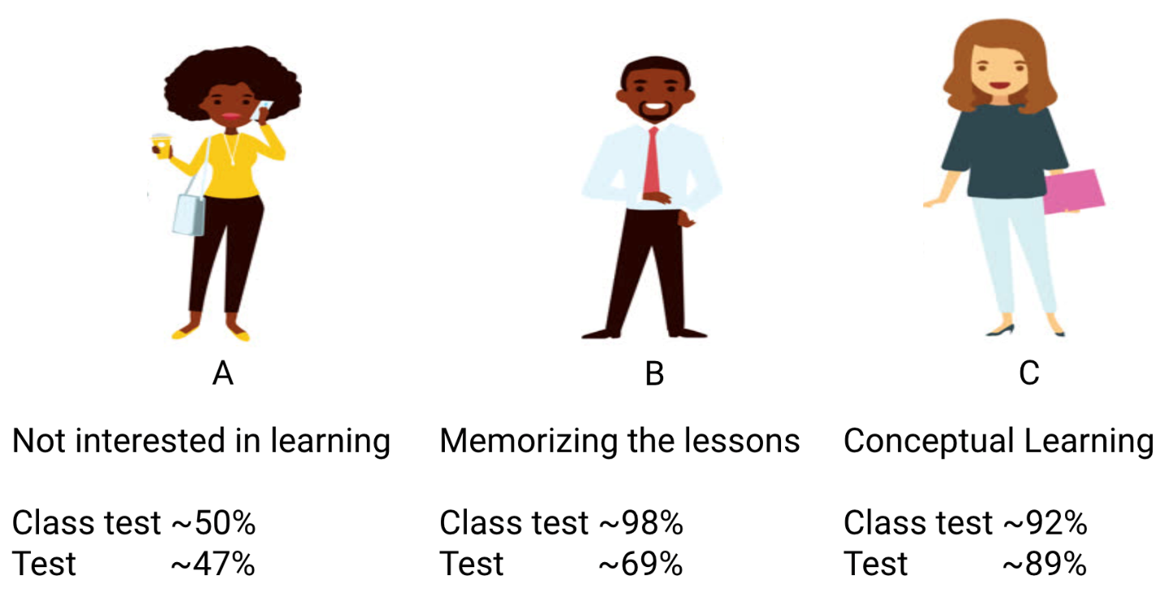
Over-fitting & Under-fitting

Slide 8
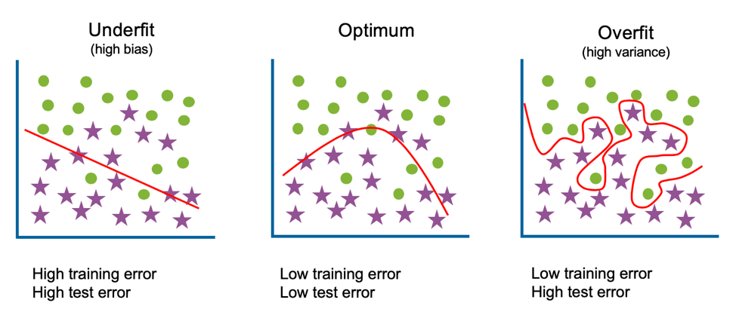
Over-fitting & Under-fitting

Slide 9
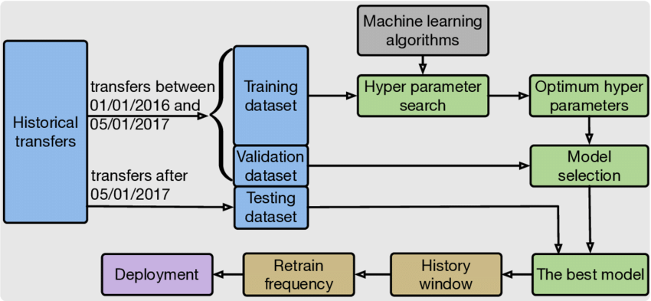
Model Selection

Slide 10
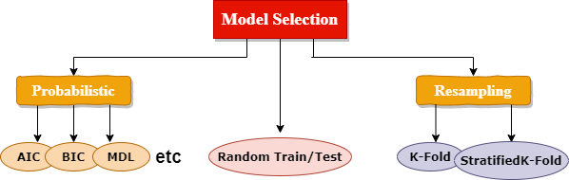
Model Selection

Slide 11
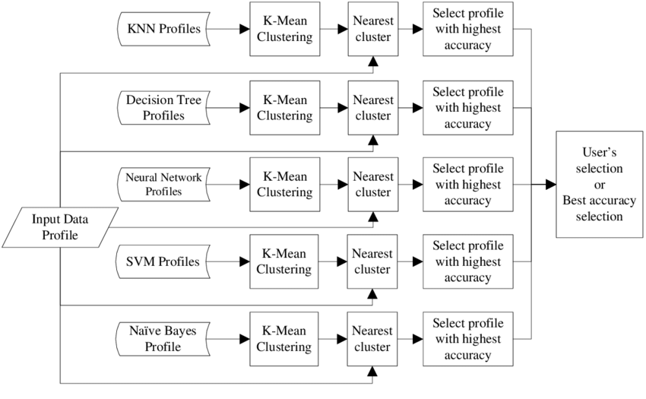
Model Selection

Slide 12
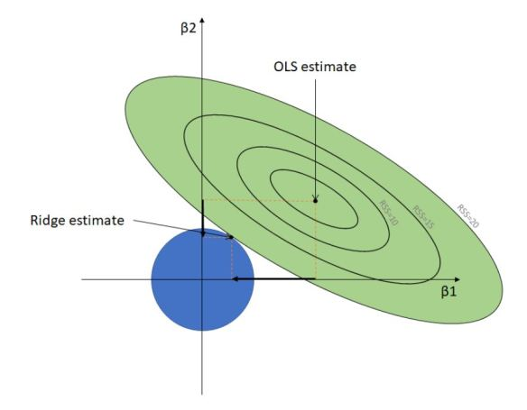
Ridge Regression

Slide 13
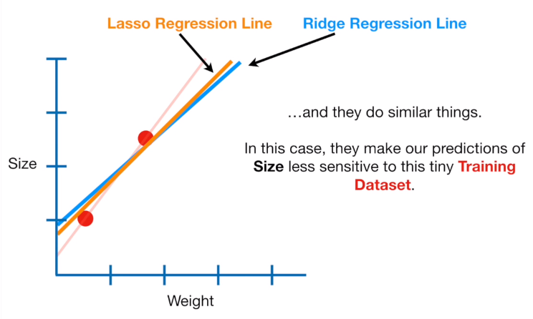
Ridge Lasso Regression

Slide 14
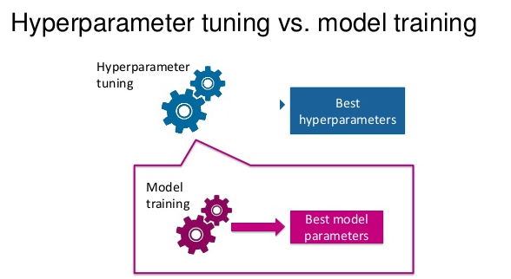

Slide 15
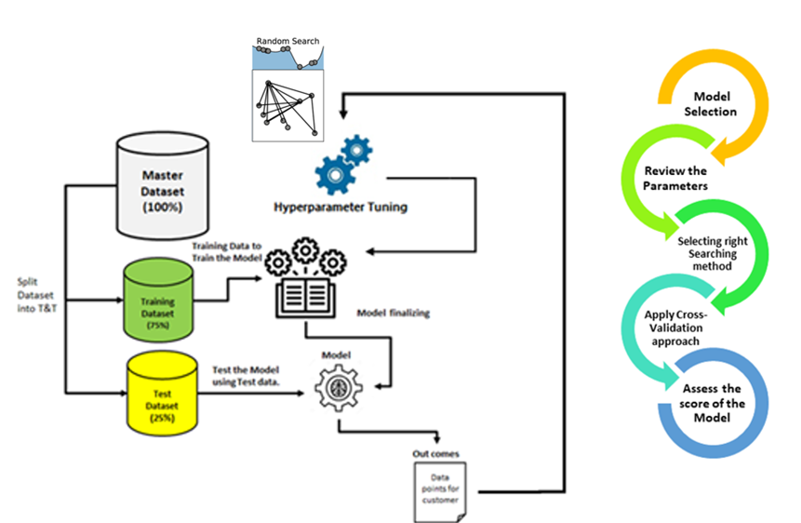
Hyper-Parameter-tuning

Slide 16
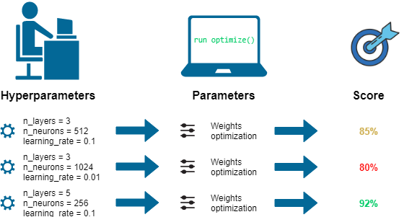
Hyper-Parameter-tuning

